Slide 1
Business Continuity Plan & Disaster Recovery
Group 3
MADDI KAMAL DIVYA | YARE FENG SHUI
LI JIACHEN | XU HAODI
JAGADEESH CHIRUMAMILLA | ROHAIZAD BIN NOORDIN

Slide 2
Current state of the art
Key components to Business Continuity
Current technology
Current Infrastructure

Slide 3
Key Component to Business Continuity
Resilience
Fast Recovery
Contingency plan

Slide 4
Current Technologies
Current Infrastructures
Server virtualisation
Cloud Disaster recovery
Green Technologies
Data deduplication
Uninterruptible Power Supply
Hot or Cold Site

Slide 5
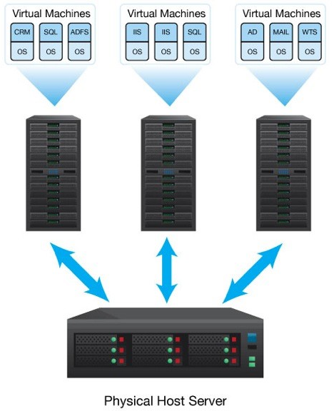
Server Virtualisation
Virtualisation reduces the number of physical servers needed while increasing the utilisation level of the other servers.
Server virtualisation partition a physical server into multiple servers isolated virtual environment. Each with capabilities of operating and running on its own machine.

Slide 6
Benefits of Server Virtualization
Lower number of physical servers
Lower server reduces the hardware maintenance costs
Increase space utilisation efficiency in data centers
Consolidating server will save space in the data environment
Less dependency between applications
Virtual servers prevent one application from impacting another application when there are changes and upgrades made to the servers.
Multiple OS
Various operating systems can be deployed on a single hardware platform through server virtualisation.

Slide 7
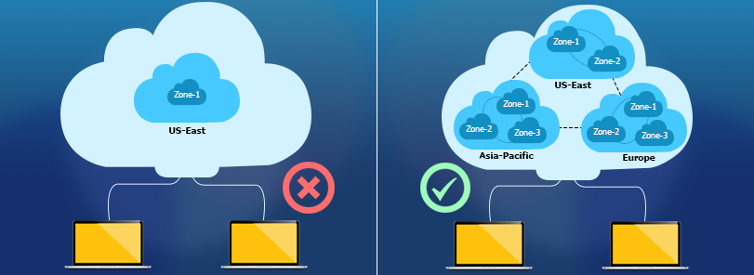
Cloud Disaster Recovery
Backup and restore strategy that involves storing and maintaining copies of electronic records in a cloud computing environment as a security measure.
Benefits:
Ability to recover all workload and data in the cloud
Variety of ways it can be implemented
in-house, partially in house,
purchased as a service
Unlimited scalability
Highly Secure and reliable infrastructure

Slide 8

Green Technology
Use of green facilities to reduce expensive infrastructure upgrade to manage the power and cooling requirements
Free air cooling
On- site wind generation or use of renewable energy
Low-power servers
Data centre virtualisation and consolidation
Cloud computing
Modular data centres
https://www.computerweekly.com/feature/Top-technologies-that-can-make-your-datacentre-green

Slide 9
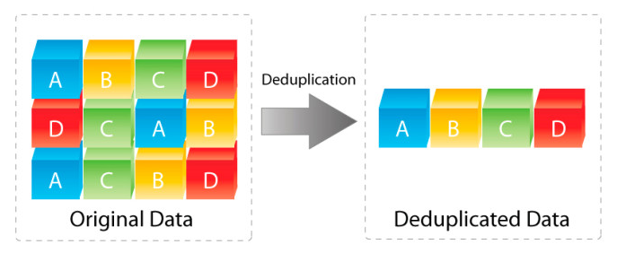
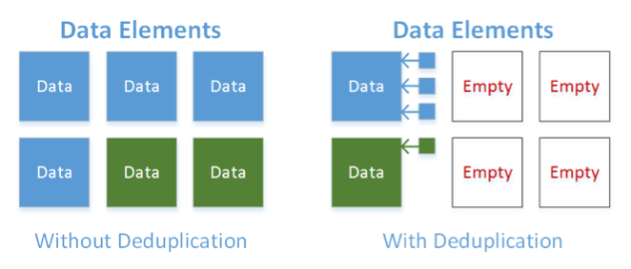
Data deduplication
Notes:
With deduplication, you can store just one copy of these individual virtual machines and then allow the storage array to simply place pointers to the rest. Each time the deduplication engine comes across a piece of data that is already stored somewhere in the environment, rather than write that full copy of data all over again, the system instead saves a small pointer in the data copy’s place, thus freeing up the blocks that would have otherwise been occupied.

Slide 10
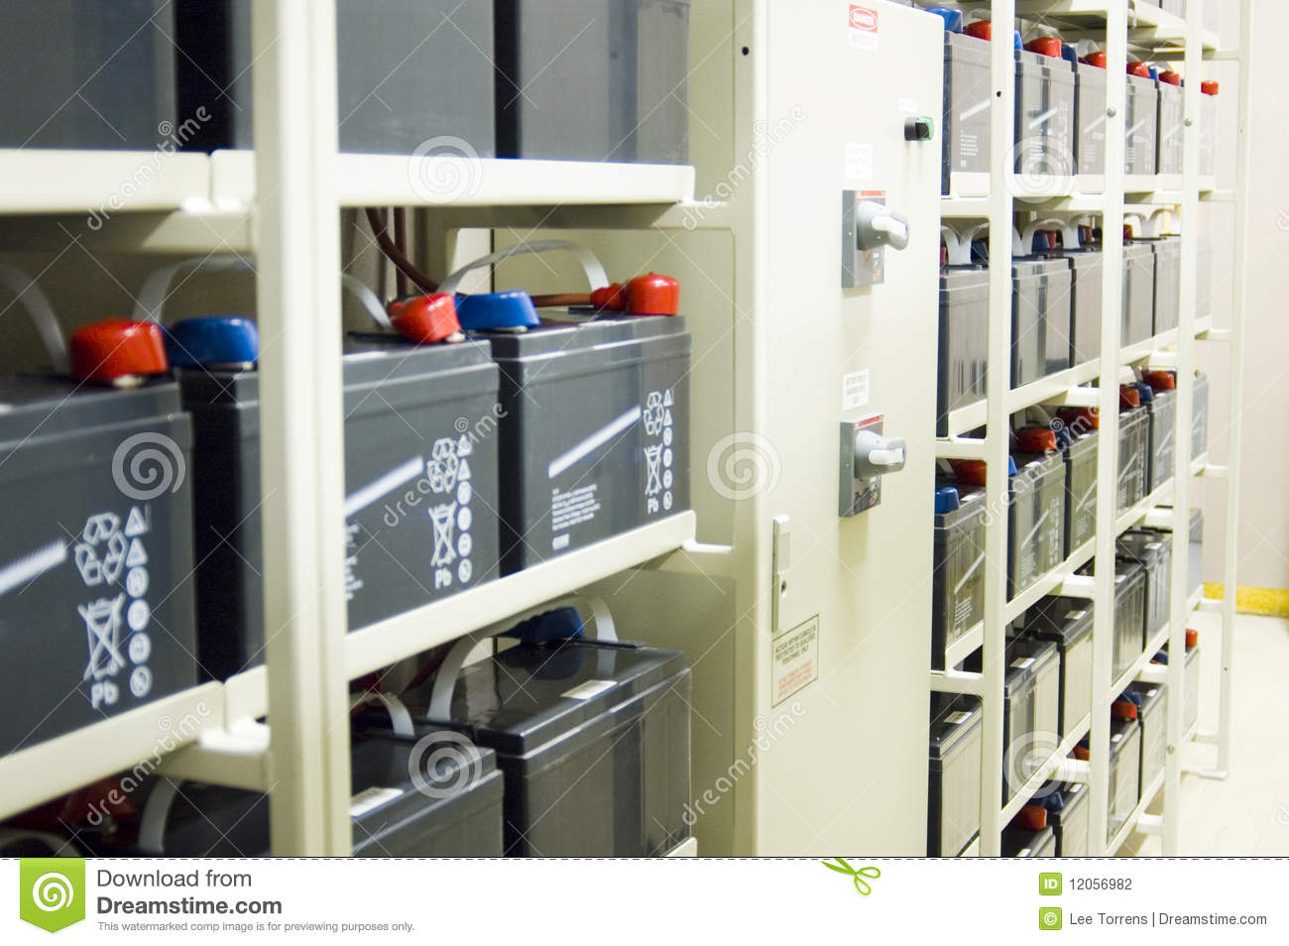
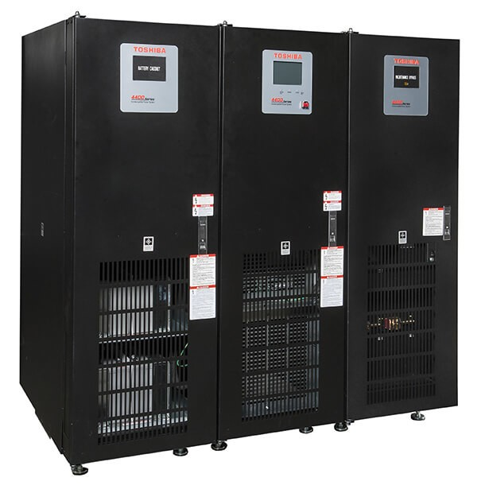
Uninterruptible Power Supply (UPS)
Notes:
UPS, also known as Uninterruptible Power Supply. It is essentially a battery used in the critical infrastructure of the company such as Data Center, Server and etc. As these critical infrastructure are powered by electricity, a single point of failure could happen if company depend solely on one power supply. Besides that, UPS is also used to combat against unstable voltage etc. Till date, company is still using UPS to combat against power failure, unstable voltage as it remained to be the most direct and effective way.

Slide 11
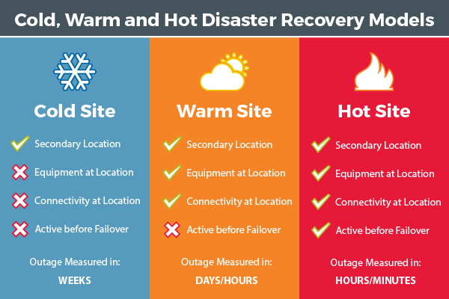
Hot / Warm / Cold Site
Notes:
Next, Hot, Warm and Cold Site are another method to ensuring business continuity plan. Hot, Warm and Cold Site are alternative site used in Business Continuity Plan. In case of disaster, company could migrate the business operation to this alternate site. The difference between these three site is the readiness of the infrastructure and facilities. As the “temperature” of the site goes up, the more equipped facility it is and minimize the setting up. However, the cost is also higher with the available of the infrastructure and facilities. Company usually select the site based on their budgets and needs. However, in the recent years, companies are increasing using laptop for work and some company do also have an Virtual Private Network and data centre which reduce the high dependent on needing a hot site.

Slide 12
Current challenges and issues
Establish the business continuity plan
Maintain the business continuity plan
Maintain the disaster recovery plan
Technical implementation bottlenecks
Meeting RPO/RTO
Regulatory Issues and High Costs

Slide 13
Establish the business continuity plan
The business disaster recovery goal is not clear
Information system disaster preparedness coverage is insufficient
Disaster preparedness resources effective guarantee is insufficient
Notes:
The lack of risk assessment and business impact analysis, as well as the lack of cost and benefit measurement of business interruption loss and disaster preparedness construction investment, has led to the blind investment, lack of planning and insufficient coverage of disaster preparedness systems in the construction of disaster preparedness systems and scientific and technological emergency response systems.

Slide 14
Maintain the business continuity plan
Lack of clear decision hierarchy
Not implement test plans
Not enough training
Lack of updated plan
Notes:
Despite the pressure of national or regulatory policies, operation needs, and clients’ demands, companies nowadays lack subjective will, hold insufficient understanding of the importance and the value of business continuity management and don’t form an effective BCM system. They may think that “large investment, small return”. Since the business continuity plan is not regarded as the core business in most companies, there may be some gaps or hindrance in management part at most times.

Slide 15
Some Possible Issues
Maintain the disaster recovery plan
Technical implementation bottlenecks
Meeting RPO/RTO
Regulatory Issues and High Costs
Notes:
In the field of backup and disaster recovery, different situations in regard to clients’ expectations, demands and some objective factors may require different solutions so it may be hard to consider completely. Once companies took use of inaccurate technology, this would not only have backup role, but in the event of failure could have greater losses. It would be a challenge but also an opportunity that more mature technologies such as cloud need to be applied to the actual process more appropriately.
Meeting a high-efficiency RPO and RTO require a lots of compute resources and steady hardware support.
Many DR solutions required specific secondary data center and servers to handle the duplicated data in the event of the disaster.

Slide 16
Future Trends
Migrating to the cloud
Virtualization
Disaster Recovery as a Service (DRaaS)
Outsourcing
Underwater data centers
Movable Data centers

Slide 17
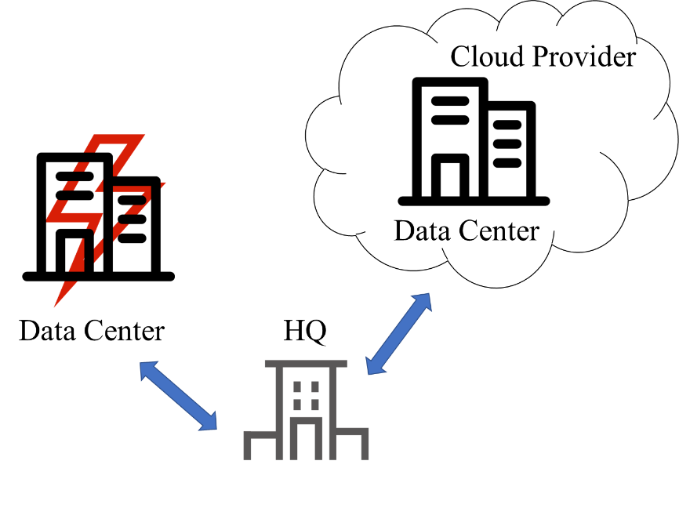
Migrating to the cloud
1. On premise cloud as BC/DR plan
The enterprise infrastructure will be on premise.
It delivers convenience, flexibility and economic value.
Organizations has to carefully review the service level agreement

Slide 18
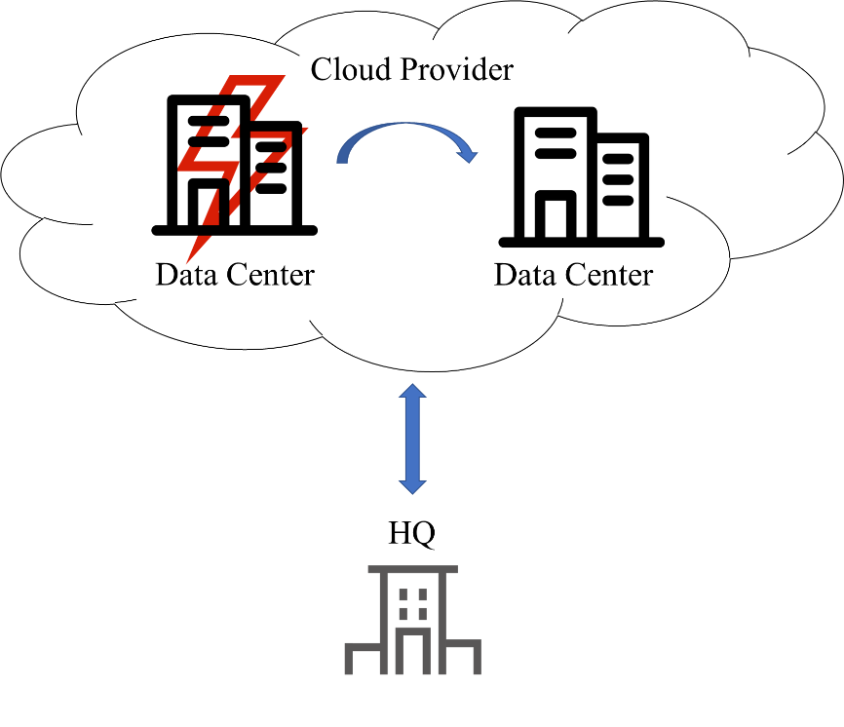
Migrating to the cloud
2. Cloud user, primary BC/DR cloud provider
Organizations infrastructure is already moved to the cloud.
The current cloud provider acts as the primary agent for BC/DR implementation.
It reduces the data center’s capacity requirements and platform management.
Security threats may be there as data is not inhouse.
Regional failures can be handled, completely depends on the provider capabilities.

Slide 19
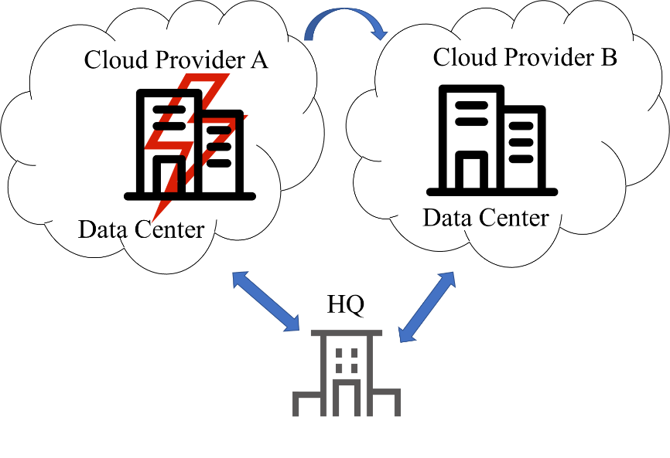
Migrating to the cloud
3. Cloud user, Alternative BC/DR cloud provider
The organization’s infrastructure is already with one cloud vendor, but BC/DR will be provided by the alternative cloud provider.
The complete failure of the primary cloud can be handled
Organization need to check the failover time as resource switching from one cloud to another cloud will take time
Organizations are increasingly opting for vendor - agnostic models to avoid lock in

Slide 20
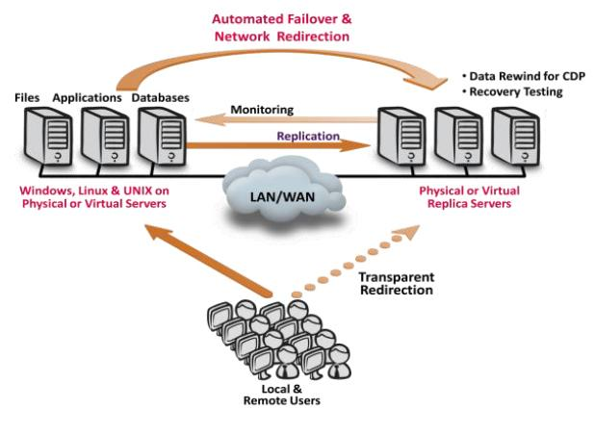
Virtualization
A software will simulate the existing hardware to create a virtual computer.
A single server can run more than one virtual system,
different operating systems and applications.
Need to assess first how many servers, need to
backup and create full image of information
which we call server consolidation ratio.
The first important is given to the servers which
are hosting mission critical information
EX: email services and inhouse built applications.

Slide 21
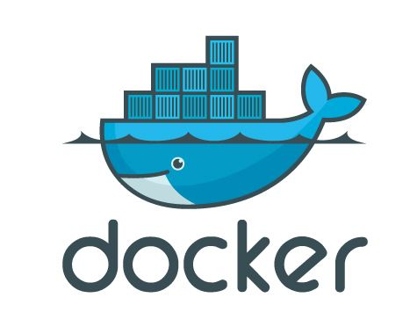
Virtualization
• Failover takes very less time as the images exists in real time
• Drawbacks of this is the data integrity as the databases of each setup is different
• Another way of implementation is using the docker containers which helps to reduce the setup time and uses the light weight containers.
Benefits:
Server Utilization
Backup and Recovery
Energy conservation

Slide 22
Disaster Recovery as a Service
Can specify a recovery point objective, a recovery time target and a recovery data region during the DR test.
Generate a scenario for disaster recovery test.
DRaaS allows organizational applications to run on virtual machines
Advantages:
Multisite
Array agnostic
Granular or comprehensive
Additional Services

Slide 23

Outsourcing
will avoid unknowingly putting an organization at risk.
evolving trends is confusing
Advantages:
Transferring the Risk
Infrastructure as a Service (IaaS)
Outsourcing provides compliance guidance
Risk Assessment and Mitigation

Slide 24
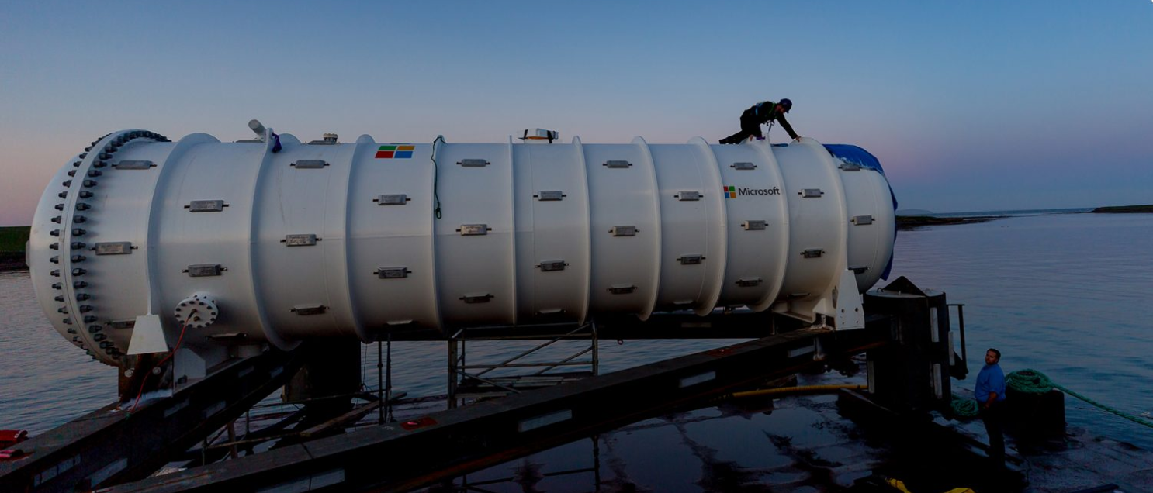
Underwater Data Centers - Microsoft ’s Project Natick

Slide 25
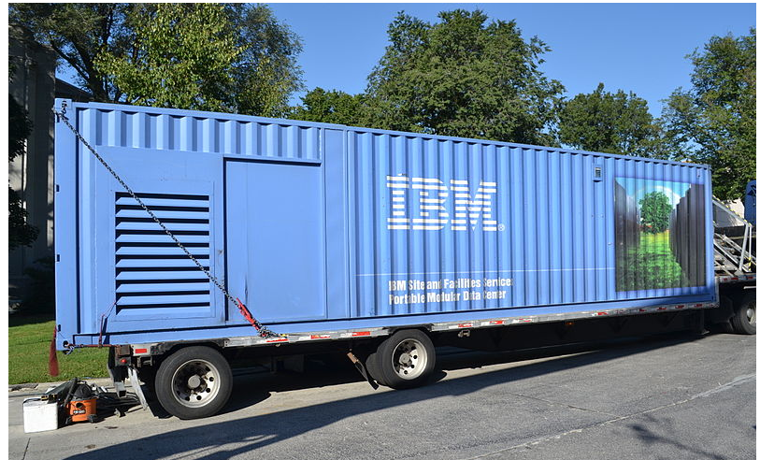
Movable Data Centers

Slide 26
Q & A
THANK YOU

